Slide 1

Hotel Reservation Management System
G.Keerthi Harshana:25B11CS269
T.Radhika:25B11CS945
T.Lakshmi Sowjanya:26B21CS070
R.Pavithra:25B11CS804

Slide 2

Introduction
A hotel reservation management system helps customers book rooms easily and efficiently.
It allows users to check room availability and select suitable rooms.
The system stores customer and reservation details securely.
It reduces manual work and minimizes booking errors.
It provides an organized way to manage bookings, cancellations, and customer information.

Slide 3
Problem Statement
Manual hotel bookings are time-consuming and error-prone.
Checking room availability manually is difficult.
Managing customer and booking details can be inefficient.
Booking conflicts may occur due to poor record management.
A computerized system is needed to manage reservations efficiently.
The Hotel Reservation Management System is developed to overcome these problems by storing and managing hotel-related information in a centralized MySQL database.
The system helps manage customer details, hotel information, room details, reservations, payments, and staff information efficiently.

Slide 4
Objectives
The main objectives of the Hotel Reservation Management System are:
To manage customer information efficiently.
To manage hotel and room details.
To check room availability quickly.
To create, update, and cancel room reservations.
To maintain payment information.
To reduce manual work and paperwork.
To minimize errors and duplicate bookings.
To maintain accurate and consistent records.
To provide quick access to customer, room, and reservation information.
To improve the overall efficiency of hotel management.

Slide 5
Functional Requirements
User registration and login.
Search available rooms by date and type.
View room details, price, and availability.
Make and confirm room reservations.
Modify or cancel reservations.
Store and manage customer information.
Calculate booking cost and generate bills.
Process payment details securely.
Send booking confirmation and notifications.
Admin can manage rooms, bookings, and customers.

Slide 6
Non-Functional Requirements
System should be easy to use.
System should provide fast response time.
System should ensure data security.
System should be reliable and available.
System should support multiple users.
System should maintain data accuracy.
System should be easy to maintain.
System should be scalable for future needs.
System should provide secure user authentication.
System should have minimal system downtime.

Slide 7
End Users Of The System
Customer/Guest – Searches for rooms, checks availability, makes reservations, and cancels bookings.
Receptionist – Manages customer check-in, check-out, and reservations.
Hotel Manager – Monitors rooms, bookings, customers, and hotel operations.
Administrator – Manages users, rooms, hotel details, and system records.

Slide 8
Attributes And Entities
1. Customer Customer_ID Name Phone Email Address
2. Room Room_ID Room_Number Room_Type Price Status
3. Reservation Reservation_ID Customer_ID Room_ID Check_In_Date Check_Out_Date Booking_Status
4. Staff Staff_ID Staff_Name Phone Role Salary
5. Hotel Hotel_ID Hotel_Name Location Phone Email
6. Payment Payment_ID Reservation_ID Payment_Date Amount Payment_Method Payment_Status

Slide 9
Hotel Reservation Management System
REVIEW 2
G.Keerthi Harshana:25B11CS269
T.Radhika:25B11CS945
T.Lakshmi Sowjanya:26B21CS070
R.Pavithra:25B11CS804

Slide 10
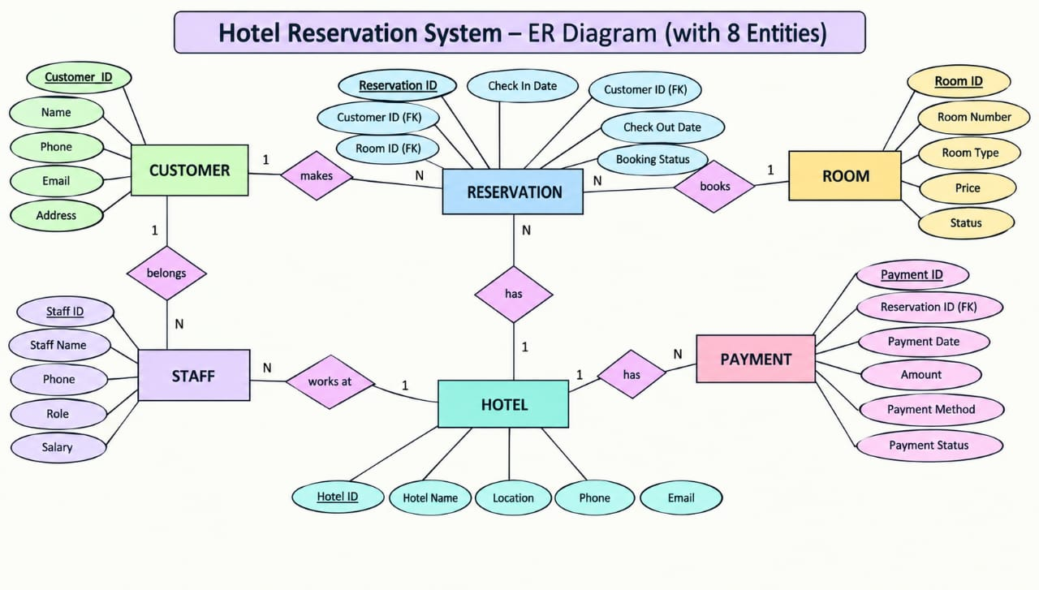

Slide 11
1. Your ER diagram
8 Entities:
CUSTOMER
ROOM
RESERVATION
STAFF
HOTEL
PAYMENT
BOOKING
REVIEW

Slide 12
SQL Creation
1.Hotel Table 2.Customer Table
CREATE TABLE HOTEL (
Hotel_ID NUMBER PRIMARY KEY,
Hotel_Name VARCHAR2(50) NOT NULL,
Location VARCHAR2(50) NOT NULL,
Phone VARCHAR2(15) UNIQUE,
Email VARCHAR2(60) UNIQUE
);
CREATE TABLE CUSTOMER (
Customer_ID NUMBER PRIMARY KEY,
Name VARCHAR2(50) NOT NULL,
Phone VARCHAR2(15) UNIQUE,
Email VARCHAR2(60) UNIQUE,
Address VARCHAR2(100)
);

Slide 13
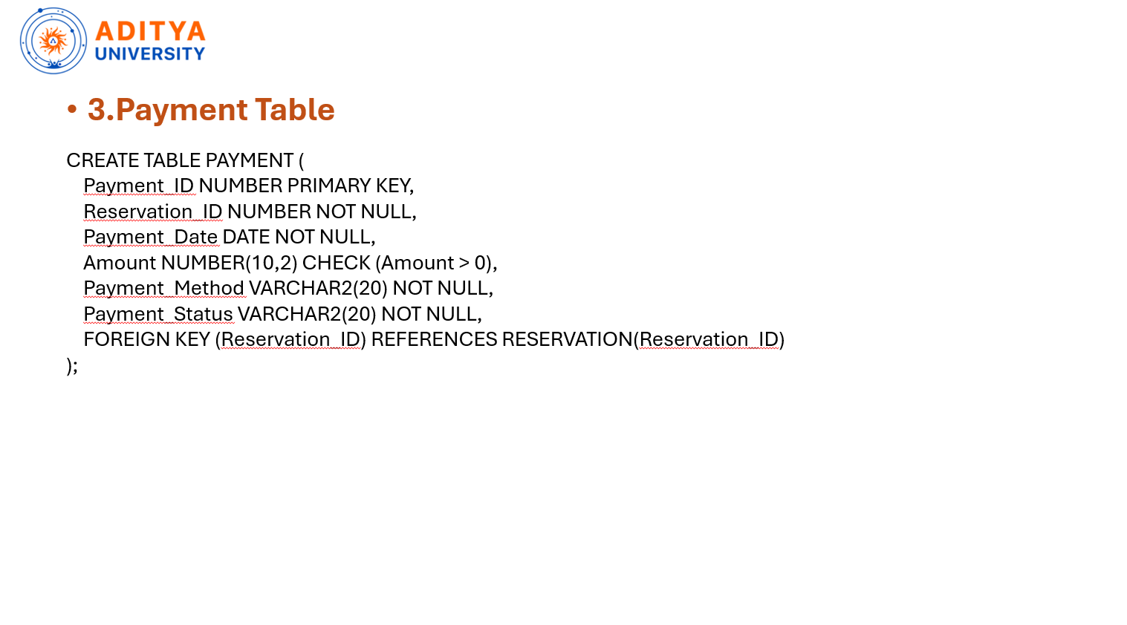

Slide 14
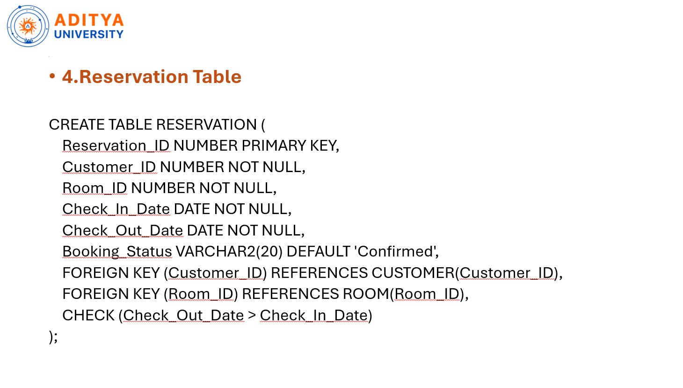

Slide 15
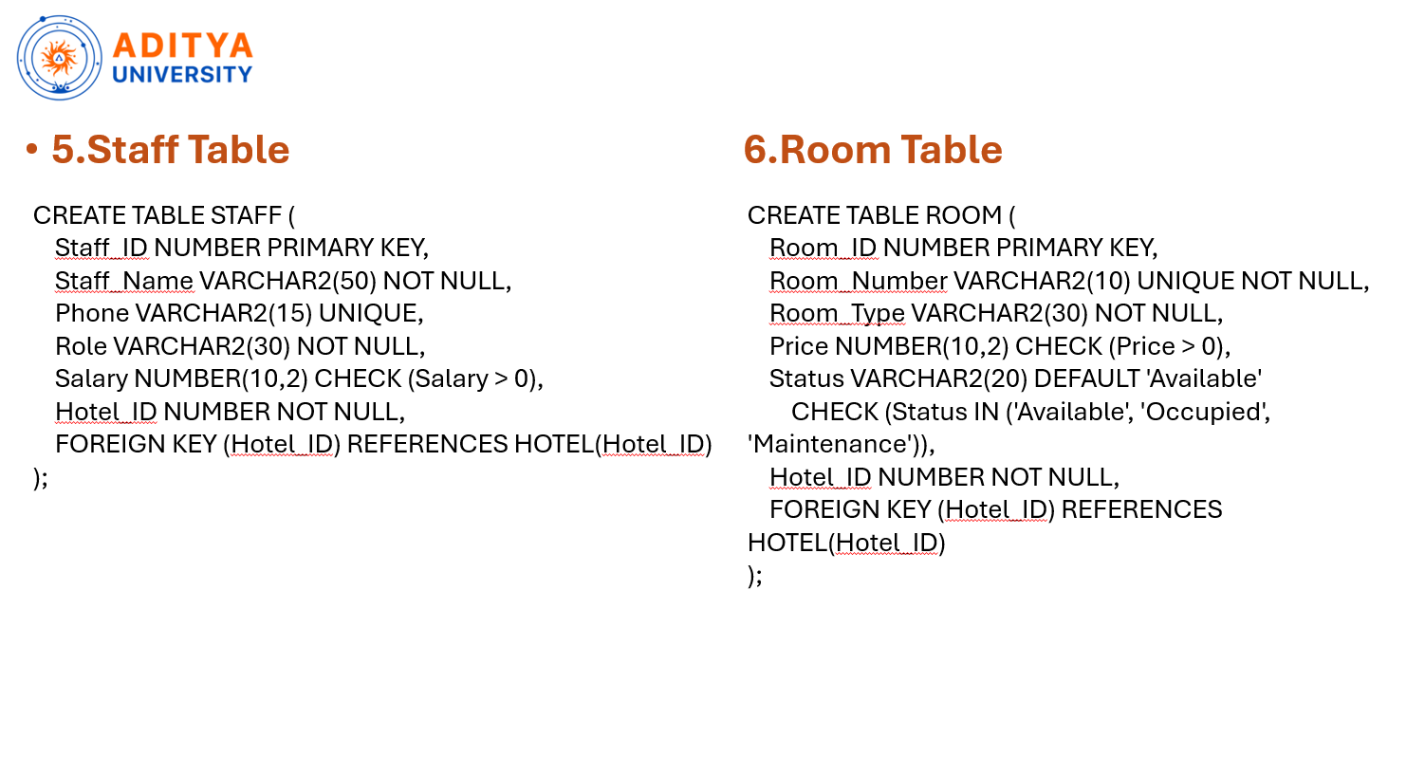

Slide 16
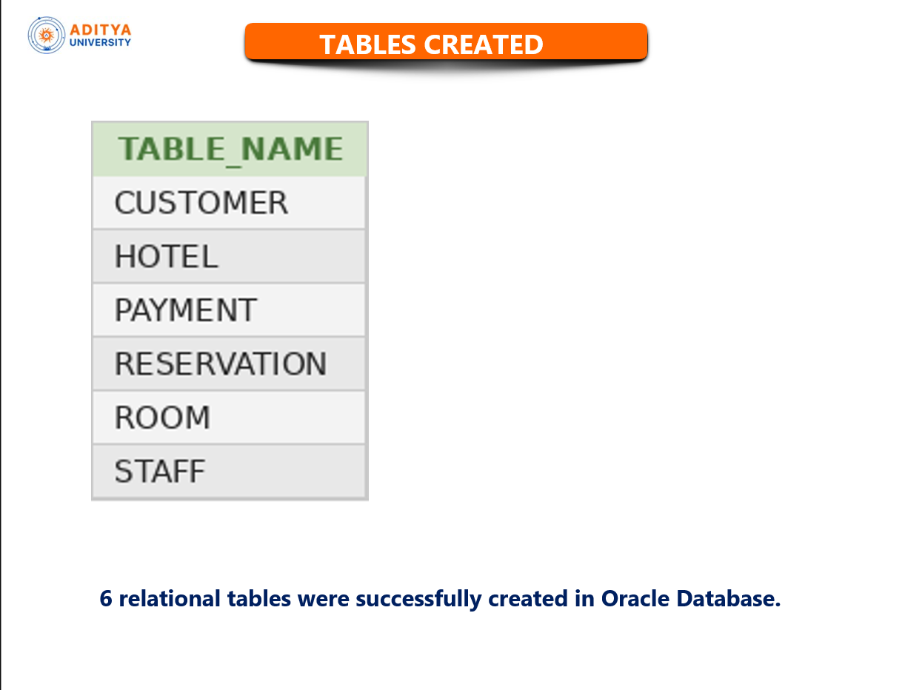

Slide 17
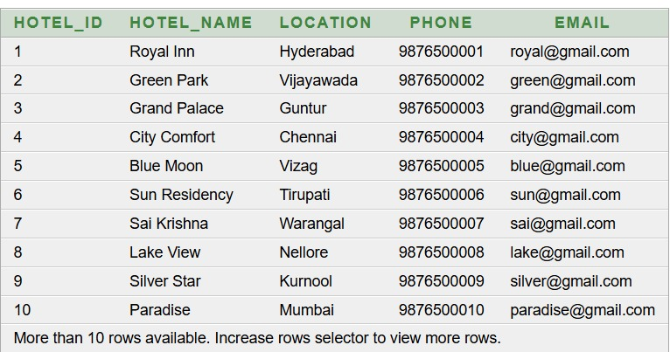
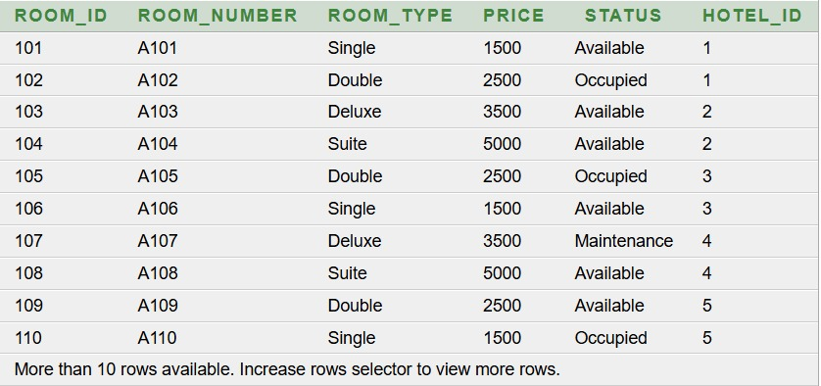
Sample Records
Hotel Table Room Table
SQL>SELECT * FROM HOTEL; SQL>SELECT * FROM ROOM;

Slide 18
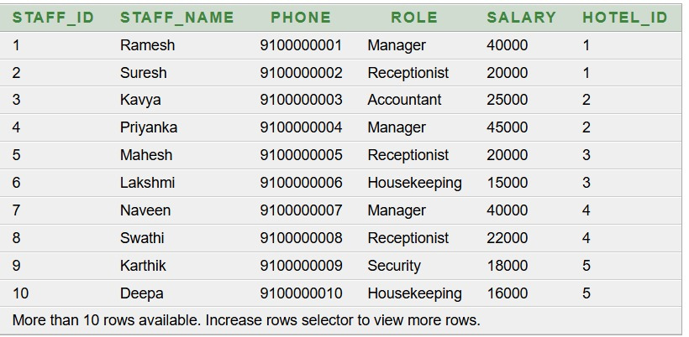
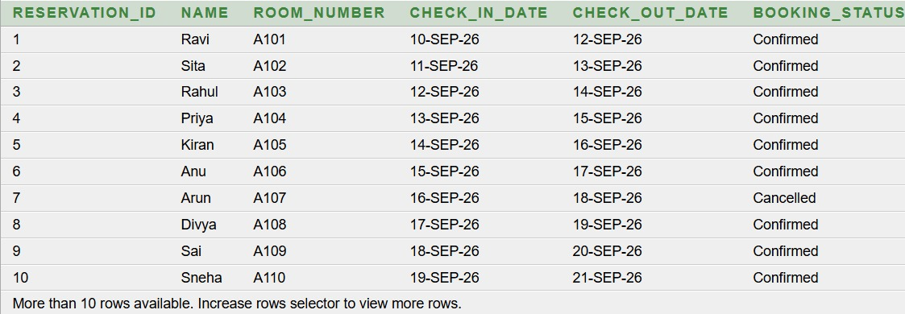
.
Staff Table Reservation Table
SQL>SELECT * FROM STAFF SQL>SELECT * FROM RESERVATION

Slide 19
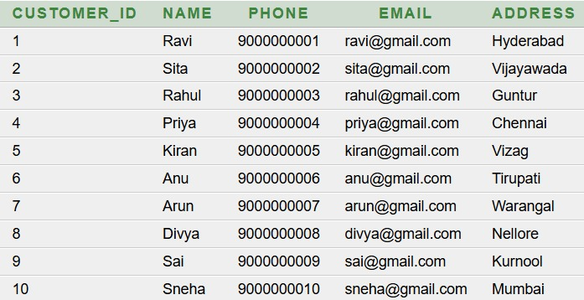
.
Customer Table
SQL>SELECT * FROM CUSTOMER

Slide 20
Basic Queries and Outputs
Q1. Display all customer details
SELECT * FROM CUSTOMER;
Output:

Slide 21
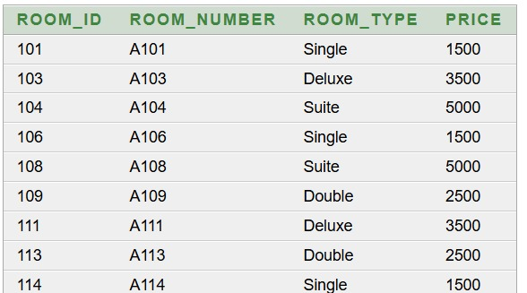
.
Q2. Display all available rooms
SELECT Room_ID, Room_Number, Output:
Room_Type, Price
FROM ROOM
WHERE Status = 'Available';

Slide 22
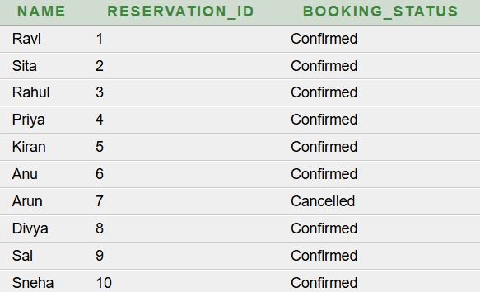
.
Q3. Display customer names and reservation status
SELECT c.Name,
r.Reservation_ID,
r.Booking_Status
FROM CUSTOMER c
JOIN RESERVATION r
ON c.Customer_ID = r.Customer_ID;
Output:

Slide 23
.
Q4. Display reservation details with customer and room information
SELECT r.Reservation_ID,
c.Name,
rm.Room_Number,
r.Check_In_Date,
r.Check_Out_Date,
r.Booking_Status
FROM RESERVATION r
JOIN CUSTOMER c
ON r.Customer_ID = c.Customer_ID
JOIN ROOM rm
ON r.Room_ID = rm.Room_ID;
Output:

Slide 24

.
Q5. Find the total paid amount
SELECT SUM(Amount) AS Total_Paid
FROM PAYMENT
WHERE Payment_Status = 'Paid';
Output:

Slide 25
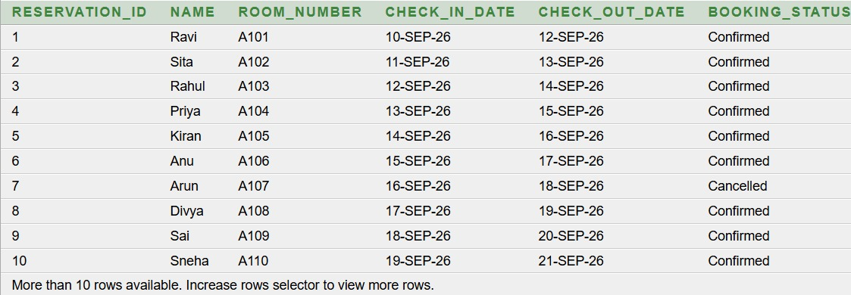
.
Q6. Display hotel names and staff working in them
SELECT h.Hotel_Name,
s.Staff_Name,
s.Role
FROM HOTEL h
JOIN STAFF s
ON h.Hotel_ID = s.Hotel_ID;
Output:

Slide 26
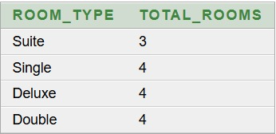
.
Q7. Count rooms by room type
SELECT Room_Type,
COUNT(*) AS Total_Rooms
FROM ROOM
GROUP BY Room_Type;
Output:

Slide 27
Normalisation
1NF – First Normal Form
Contains atomic (single) values
Avoids repeating groups
Each record has a unique primary key
2NF – Second Normal Form
Must already satisfy 1NF
Eliminates partial dependency
Every attribute depends on the entire primary key
3NF – Third Normal Form
Must already satisfy 2NF
Eliminates transitive dependency
Non-key attributes should depend only on the primary key

Slide 28

.
FIRST NORMAL FORM
The table is in 1NF because all attributes contain atomic values. However, customer and room details are repeated for different reservations, which causes data redundancy.
RESERVATION_ID | CUSTOMER_ID | CUSTOMER_NAME | ROOM_ID | ROOM_TYPE
R1 | C1 | Ravi | RM1 | Deluxe
R2 | C2 | Sita | RM2 | Standard
R3 | C3 | Arjun | RM3 | Suite
R4 | C1 | Ravi | RM2 | Standard
R5 | C4 | Priya | RM4 | Deluxe
R6 | C2 | Sita | RM3 | Suite
RESERVATION_ID → CUSTOMER_ID, ROOM_ID CUSTOMER_ID → CUSTOMER_NAME ROOM_ID → ROOM_TYPE
Primary Key: (RESERVATION_ID, ROOM_ID)

Slide 29
.
Redundancy in 1NF
Customer details are repeated for C1 and C2.
Room type is repeated whenever the same room occurs in another reservation.
Repeated data increases storage and inconsistency.
Anomalies in 1NF
Update Anomaly:
If Ravi's name/details change, all rows containing C1 must be updated.
Insert Anomaly:
A new customer cannot be stored until a reservation is created.
Delete Anomaly:
Deleting the last reservation of a customer may also remove that customer's information.

Slide 30
.
Second Normal Form
2NF – Decomposition
The 1NF table has a composite primary key. Some attributes depend only on part of the composite key. Therefore, partial dependencies are removed by decomposing the table.
CUSTOMER details separated
Reservation table after removing CUSTOMER_NAME
RESERVATION_ID | CUSTOMER_ID | ROOM_ID | ROOM_TYPE
R1 | C1 | RM1 | Deluxe
R2 | C2 | RM2 | Standard
R3 | C3 | RM3 | Suite
R4 | C1 | RM2 | Standard
R5 | C4 | RM4 | Deluxe
R6 | C2 | RM3 | Suite
CUSTOMER_ID | CUSTOMER_NAME
C1 | Ravi
C2 | Sita
C3 | Arjun
C4 | Priya
Primary Key: CUSTOMER_ID
CUSTOMER_ID → CUSTOMER_NAME ROOM_ID → ROOM_TYPE
CUSTOMER_NAME is deleted from the reservation table because it depends on CUSTOMER_ID, not on the complete composite key.

Slide 31
.
.
Redundancy after 2NF
Customer names are stored only once.
Repetition of customer information is reduced.
Room information is still repeated where the same room occurs.
Anomalies after 2NF
Update anomaly: Customer name needs to be updated only once.
Insert anomaly: A customer can be added independently.
Delete anomaly: Deleting a reservation does not delete customer information.

Slide 32
.
Third Normal Form
2NF → 3NF Decomposition
The 2NF table still contains a transitive dependency because ROOM_ID → ROOM_TYPE. Therefore, room details are separated into a new ROOM table.
ROOM
Final RESERVATION table
ROOM_ID | ROOM_TYPE
RM1 | Deluxe
RM2 | Standard
RM3 | Suite
RM4 | Deluxe
RESERVATION_ID | CUSTOMER_ID | ROOM_ID
R1 | C1 | RM1
R2 | C2 | RM2
R3 | C3 | RM3
R4 | C1 | RM2
R5 | C4 | RM4
R6 | C2 | RM3
Primary Key: ROOM_ID
CUSTOMER_ID → CUSTOMER_NAME ROOM_ID → ROOM_TYPE (RESERVATION_ID, ROOM_ID) → CUSTOMER_ID
Primary Key: RESERVATION_ID, ROOM_ID

Slide 33
.
Redundancy after 3NF
Customer information is stored only in CUSTOMER.
Room information is stored only in ROOM.
Repeated customer and room details are eliminated.
Data duplication is minimized.
Anomalies after 3NF
Update Anomaly:
Customer or room details are updated in only one place.
Insert Anomaly:
New customers and rooms can be added without creating a reservation.
Delete Anomaly:
Deleting a reservation does not remove customer or room information.

Slide 34
